Slide 1
Examples trials: Free (No Belt) Agent version
Mock-up of trails for the BELT (Butterfill, Edwards & Low Task)

Slide 2
+

Slide 4
YOU

Slide 6
3

Slide 7
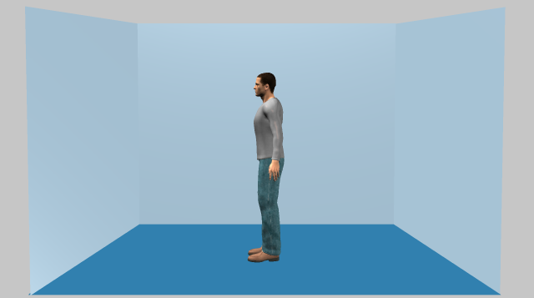
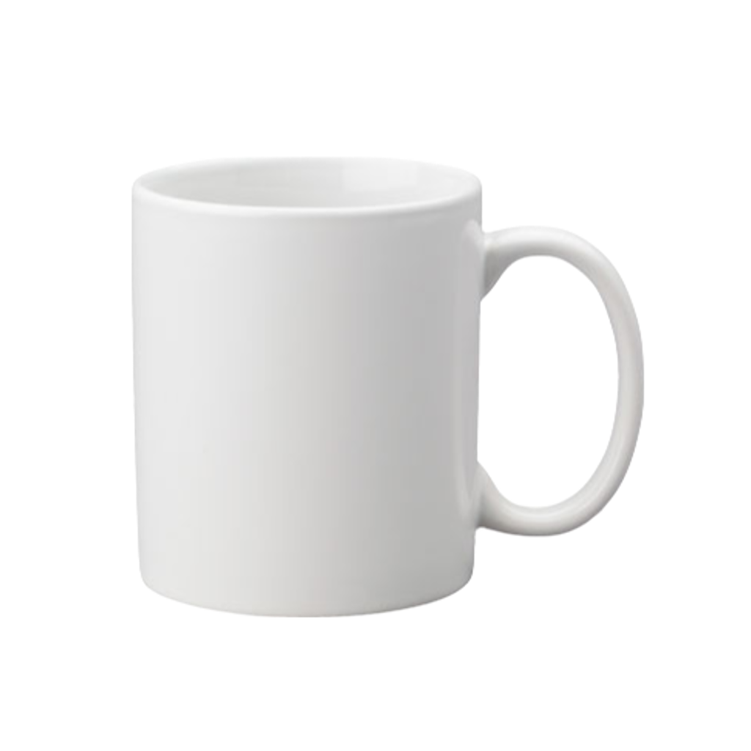
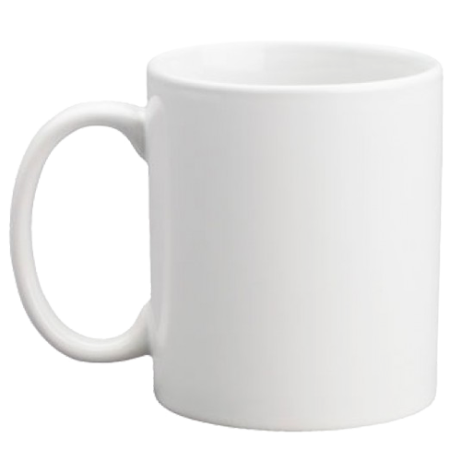
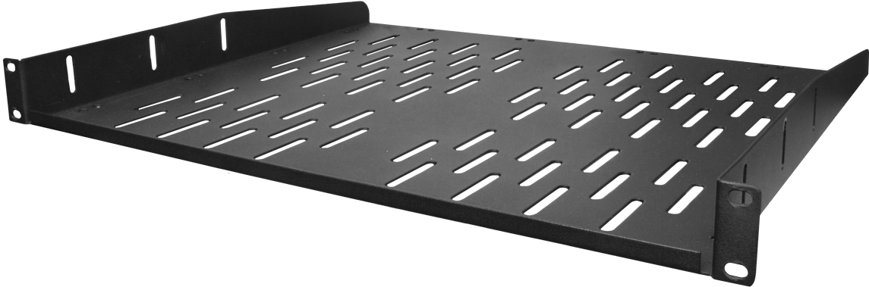
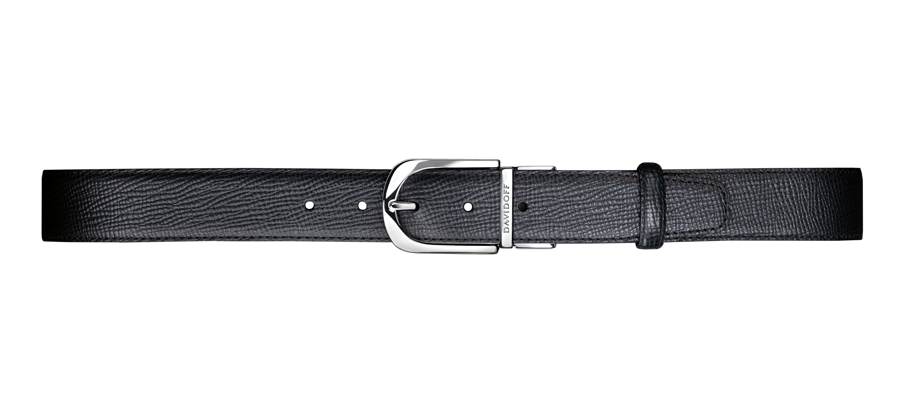

Slide 8
+

Slide 9
YOU

Slide 10
2

Slide 12
+

Slide 13
YOU

Slide 14
3

Slide 15
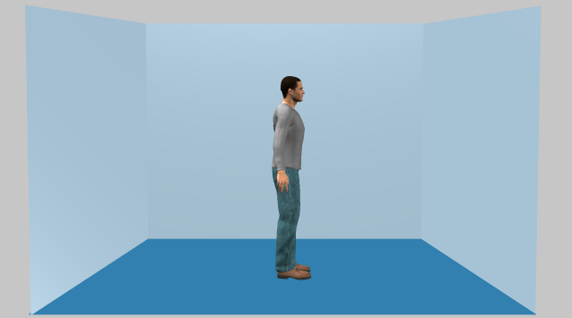

Slide 16
Example trials: Belt-Constrained-Agent Version

Slide 17
+

Slide 18
YOU

Slide 19
3

Slide 22
+

Slide 23
YOU

Slide 24
2

Slide 26
+

Slide 27
YOU

Slide 28
3

Slide 30
Example trials: Apron-Belt-Agent Version (control for perceptual novelty)
Note: The belts in the constrained-agent version are re-arranged in the form of an apron to enable the agent to potentially accomplish reach-to-grasp actions.

Slide 31
+

Slide 32
YOU

Slide 33
3

Slide 35
+

Slide 36
YOU

Slide 37
2

Slide 39
+

Slide 40
YOU

Slide 41
3

Slide 43
END

